Slide 1

SEO Keyword Tracker and Analyzer
Group #5
Rohit Bhaskar Uday, Viditi Vartak, Tushar Yadav,
Rohit Chowdary Yadla, Huan Ying, Shiyun Zhou

Slide 2
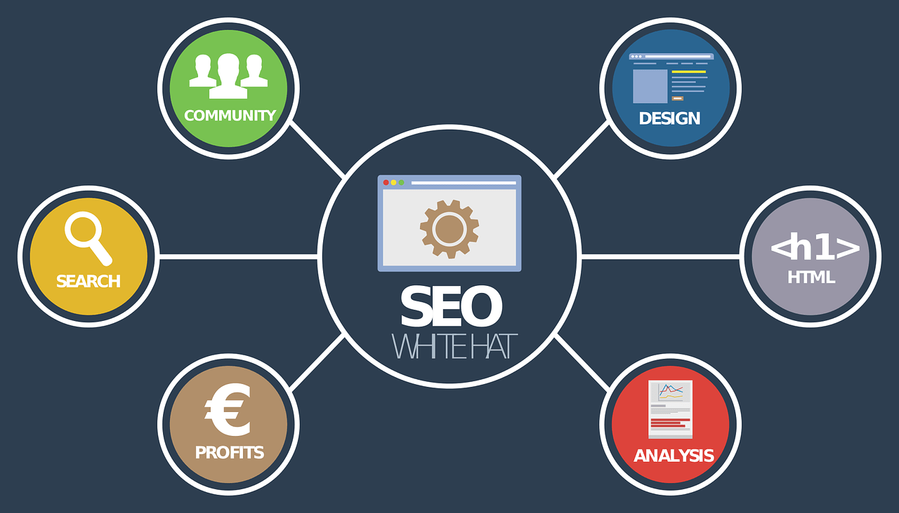
Agenda
Introduction
Algorithm Implementation
Features & UI
Testing & Refinement
Challenges & Solutions
Live Demo
Insights & Applications
Conclusion

Slide 3
1. Introduction
Objective
To develop a tool that simplifies the SEO process for professionals by utilizing advanced algorithms for keyword tracking and analysis to enhances website visibility and search engine ranking.
Approach
Integration of Rabin-Karp, Suffix Tree, Suffix Array, Naive String Matching, and KMP algorithms for efficient keyword analysis.

Slide 4
2. Algorithm Implementation
KMP Algorithm
Naive String Matching Algorithm
Rabin-Karp Algorithm
Suffix Array Algorithm
Suffix Tree Algorithm

Slide 5
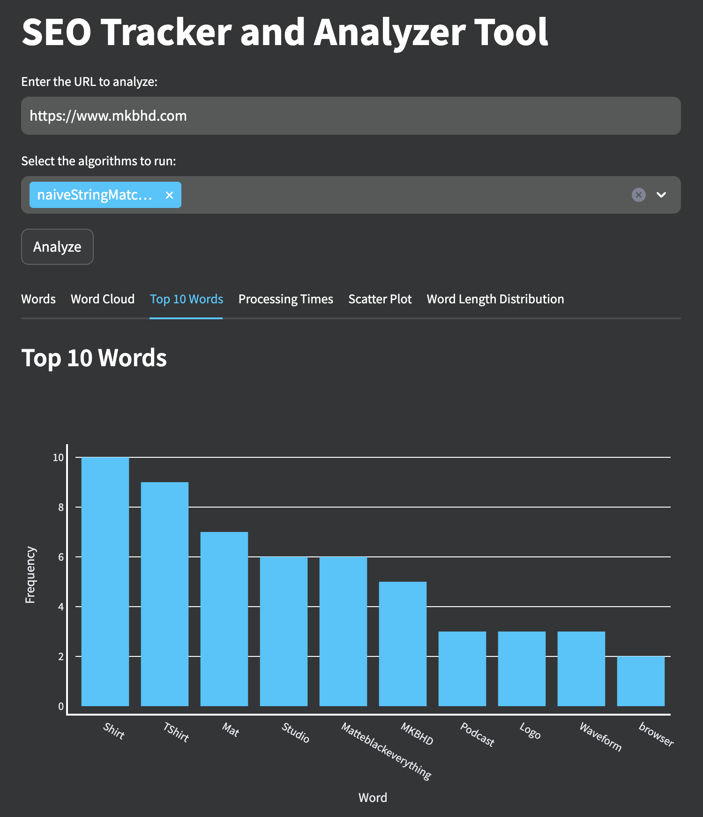
3. Features & UI
Data Scraping: Mechanism for retrieving website content through user-entered URLs.
Keyword Counting and Density Analysis: Automated counting of keyword occurrences and calculation of density for optimization recommendations.
Stopword Processing: Enhancing analysis accuracy by filtering out common and irrelevant words.
Interactive GUI: Streamlit-based interface allowing users to easily input data, choose algorithms, and visualize analysis results.

Slide 6
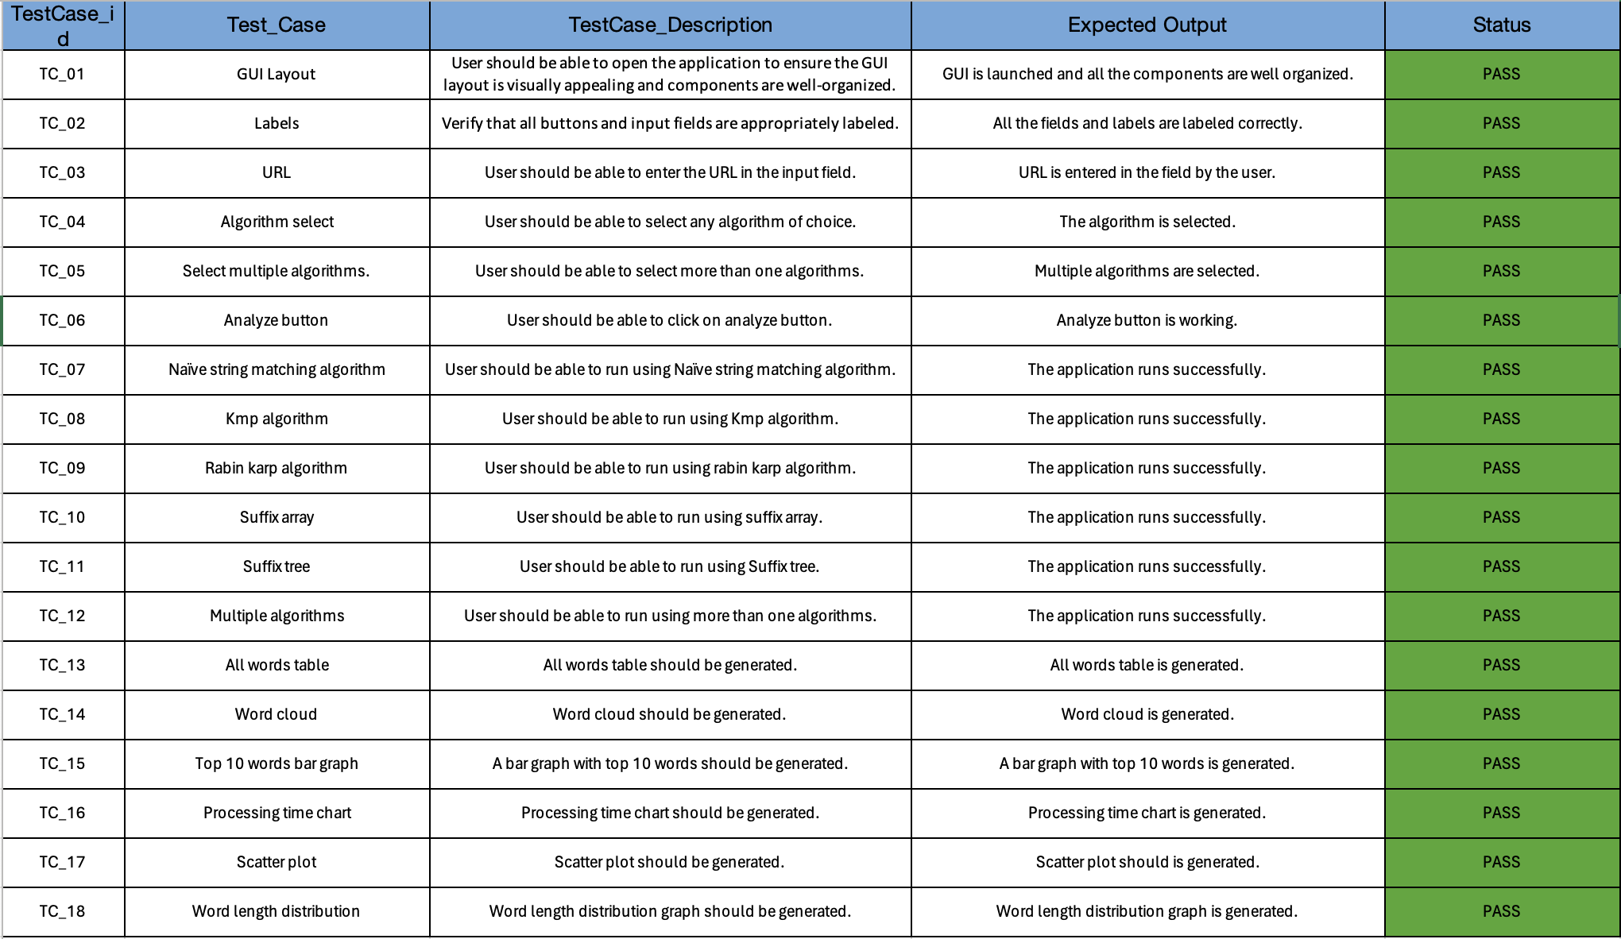
4. Testing

Slide 7
5. Challenges & Solutions
Challenge: Difficulties integrating diverse algorithms like Rabin-Karp, Suffix Tree, and KMP.
Solution: Developed a unified interface for seamless algorithm interaction, enhancing flexibility.
Challenge: Performance issues with extensive datasets.
Solution: Implemented multi-threading and algorithm optimizations, plus caching for efficiency.
Challenge: Designing an intuitive interface for complex backend operations.
Solution: Chose Streamlit for its simplicity, creating an interactive and straightforward GUI.
Challenge: Ensuring keyword relevance and effective stopword removal.
Solution: Curated extensive stopword lists and context analysis for higher accuracy.
Challenge: Graceful error management and validation of user-entered URLs.
Solution: Utilized try-except blocks for error handling and ‘validators’ library for URL validation.

Slide 8

6. Live Demo

Slide 9
7. Insights & Applications
Insights:
Knuth-Morris-Pratt (KMP): Efficient for structured, repetitive texts.
Suffix Trees: Better for unstructured data with diverse keywords.
SEO Strategies: Importance of long-tail keywords and content optimization for keyword density and relevance to boost search engine rankings.
Applications:
Digital Marketing & SEO: Ideal for content marketers to discover high-value keywords, understand competitors, and align content with search engine algorithms.
SEO Audits: Offers detailed keyword performance analysis and identifies improvement areas for better online presence and competitiveness.

Slide 10
8. Conclusion
Bridging Theory and Practice: Combines advanced algorithms with practical SEO, focusing on user-friendly design for accessible advanced analysis.
Future Enhancements:
Predictive Analytics: Incorporation of machine learning for predictive insights.
Global Language Support: To cater to a worldwide audience.
Real-Time Data Tracking: For dynamic SEO strategy adjustments.
API Integrations: Simplifying integration into digital marketing platforms.

